Slide 1
Screen for Safety
Zuckerman Institute MR Platform
Kathleen Durkin, Director, MR Research Administration
Silvia Cenzano Villagarcia, MR Safety Officer

Slide 2
MR safety involves many separate components:
-zoning
-labeling
-training
-emergency protocols
AND
-screening
Notes:
We review all of this in the MR safety training class which is required to scan at ZI. Does anyone need the link to request this class? Here’s the MR Safety Training Request Form.

Slide 3
MR safety screening: 2 sets of standards
Clinical MRI | Research MRI
Clinicians scan a patient | Researchers scan a participant
Direct benefits to the patient | No benefit to the participant
Some risk can be justified | Only minimal risk can be justified
Scan details can be adjusted for safety | Scan details are fixed, to get uniform data
Patients with implants and tattoos can usually be scanned | Participants with implants and tattoos may be barred from participation, for their own safety
Scans usually happen in hospitals with medical staff on hand | Scans may happen in research facilities with no medical staff
Notes:
Clinical scans have patients ( a person who needs an scan to optimize their health care); research scans have participants (a person who volunteers to help us advance scientific research). We follow the Department of Health and Human Services guidelines which establish that research participants should be subject to no more than than minimal risk. "Risk" for participants with medical devices or implants is determined by FDA guidelines. We will follow FDA- approved ratings for devices, and for participants with unsafe or unknown devices, the decision to allow the scan will be up to our discretion. This is why a person who got a clinical MRI as a patient may not be approved to get a research MRI as a participant. That’s the case even if they got a previous RESEARCH MRI without any issues, because that study or that scanner may have been less dangerous for them. When in doubt, ask the MR Safety Officer or the MR technologist.

Slide 4
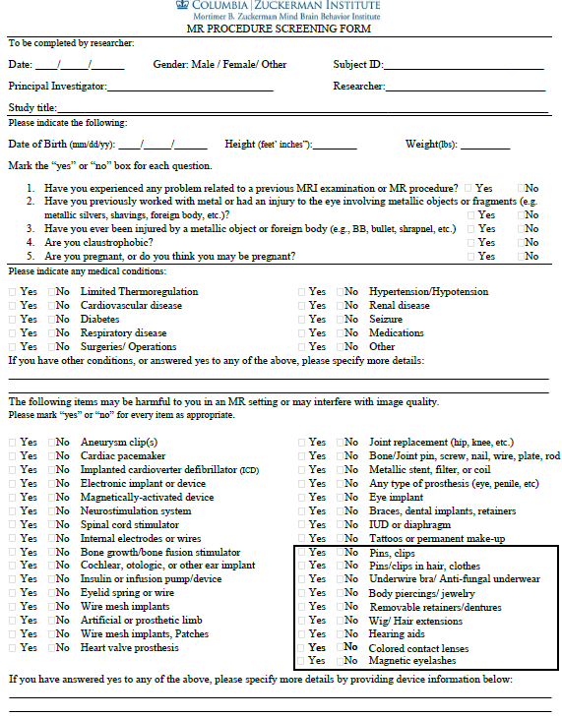
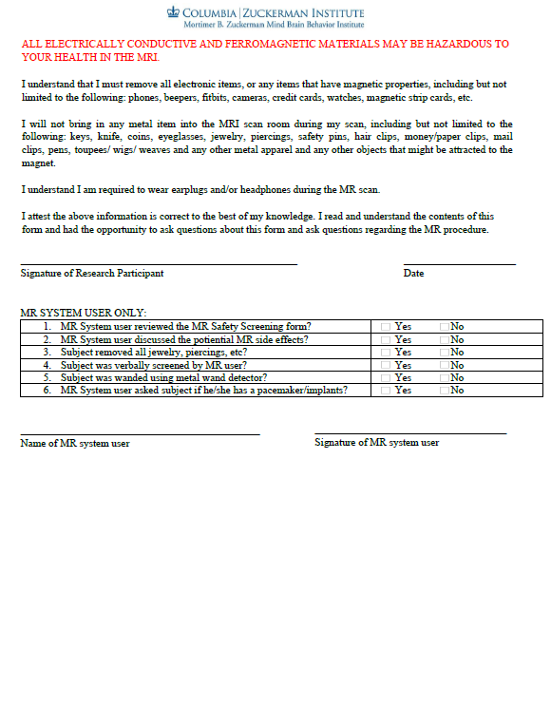
The Screening Form
https://mr.research.columbia.edu/content/screening-forms
Notes:
https://mr.research.columbia.edu/content/screening-forms This form is also available in Spanish
Schedule a 30 min phone call and go through the form, item by item.
Screen your participants for MRI as early as you can, or at least 2 days before the scan if possible. But earlier is better. I strongly recommend including this questionnaire in with your other initial screening questions. There are many reasons why: some items might take a bit of background research. How old is your tattoo, or what year was your knee replacement? I forget; I’ll have to check my old calendars. Even if they know when, they might not know the next set of details we need, like the material that makes up their knee replacement. They may need to look up which doctor operated on them, or call their primary care doc to check their medical records for the referred surgeon’s name.
Also, screening early saves you time, effort, and money. If they can’t be scanned safely and the MRI is a major part of your study, they should not enroll in your study. Now that’s 2 factors: they can’t be scanned AND the MRI is a major part of your study. If the MRI is not the primary data type of the study, like if it’s a huge multimodal study and you can afford to only scan part of your population, then feel free to enroll them.
On the day of the scan, give them this form to complete again. They may recall additional details.

Slide 5
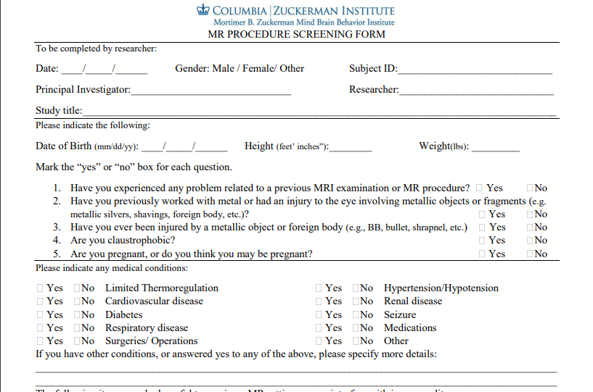
Notes:
Urge your participants to be honest and report ANYTHING they might have, to the best of their memory. A forgotten item can be a risk. Even if it’s not a risk to them, it can result in an unusable image. That’s even worse, because the scan itself is a risk (a slight risk, but a risk nonetheless) but if you don’t even get data, they took that risk for no reason. And this form is helpful to screen out items that may be safe for the participant who is getting the scan but may lead to an unusable image. Before I worked at ZI, I scanned a person with a full set of stainless steel braces. He was perfectly fine. No movement, no heating. But the braces distorted the image and we ended after the first acquisition. He got paid, but we wasted our time, money, and a scan slot. So this screener is to help you AND the participant.
Medications can give you information about a condition they have, which can give you a heads up about potential problems. If you see heart medication, ask about cardiac incidents and be sure you check if they indicated they have stents, valves, coils, or a pacemaker. If you see anxiety medication, double check if they’re also claustrophobic. Not saying the two are definitely linked, but both involve heightened activation in the amygdala and insular cortex (https://www.nature.com/articles/npp200983) so it’s always good to check. In fact, another term for claustrophobia is confinement anxiety.
You don’t need to memorize medication names. Just ask what each is for, and make a note of any that could indicate a possible MRI issue.

Slide 6
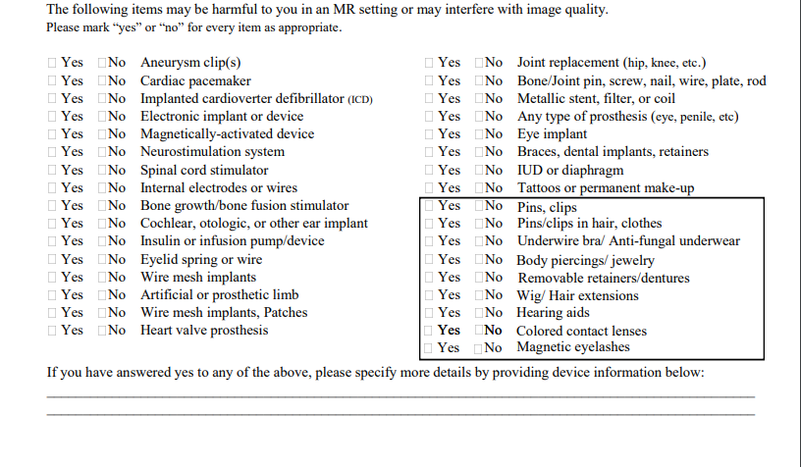
Notes:
Some of these are common, some are rare. Check for all of them. It doesn’t take long. And you booked 30 min to review this!
There’s a box on this page. Box items are removable-- in MOST cases. If they say yes in the phone screening, ask if the item can be left at home or removed before the scan. When you do the form again on scan day, make sure the items have all been removed. You will also wand them before they enter Zone 4.

Slide 7
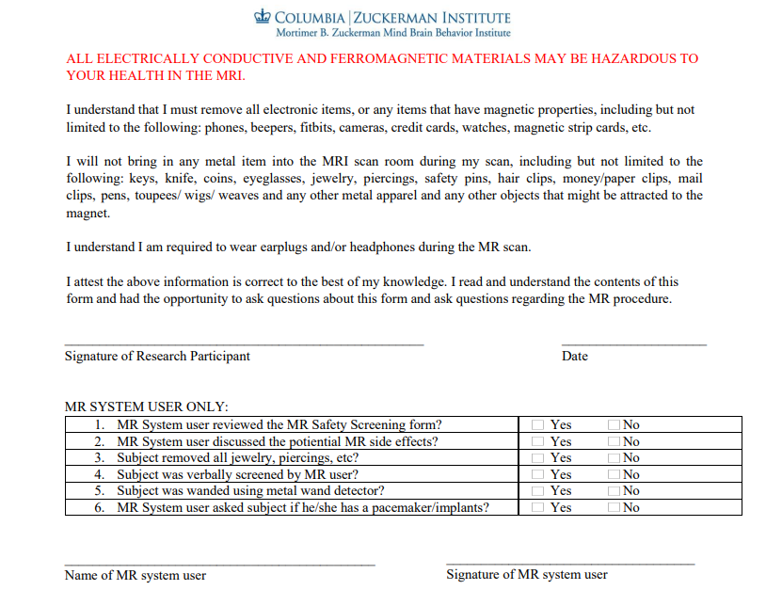
Notes:
Have them read this, or read it to them if that’s better. You will make sure they leave everything in a locker or the control room. They sign on top and the Level III person signs under the box.

Slide 8
Medical Implants or Devices
MR Safety Officer Needs:
For every medical implant or device, provide the FDA label.
To get this, find out
The make
The model
Google “make model FDA label”.
What if they have no implant card or make/ model info?
-get their doctor’s information and call them or their practice
-request medical records related to the implant (due to HIPAA, the participant may need to do this)
-check medical records for the make/ model info
Notes:
If the participant has any of the surgical implants on the checklist, get the FDA label and send it to the MR Safety Officer.

Slide 9
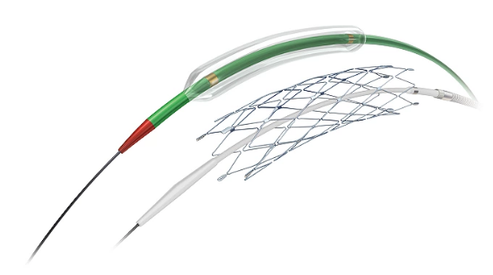
Medical Implants or Devices
FDA Label
Stryker Wingspan stent
Make: Stryker:
Model: Wingspan
Send the MR Safety Officer the URL: https://www.accessdata.fda.gov/cdrh_docs/pdf5/h050001b.pdf
Notes:
This is the kind of information the MR Safety Officer needs. It might be a paragraph like this, or a table, or a document.

Slide 10
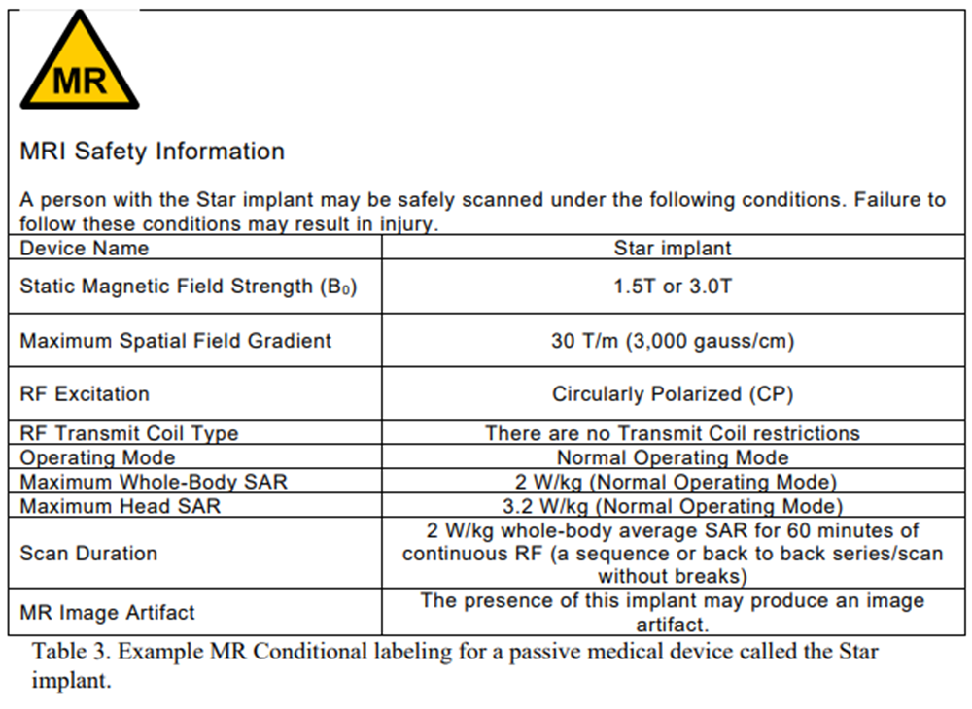
Medical Implants or Devices
FDA Label
Notes:
Another example of an FDA conditional label. This is for a STAR implant (Scandinavian Total Ankle Replacement by Stryker). This is the kind of information the MR Safety Officer needs. It might be a table like this, or a paragraph like the last slide, or a document.

Slide 11
MR Safety Officer Does Not Need:
-a letter from an MD saying the medical implant is titanium
-a letter from an MD saying it’s safe to scan this participant
-a report that the participant has had MRIs in the past without a problem
-a signed Request for Verification of MRI-Safe Implants (this is a NYSPI form, not a ZI form)
-a memo absolving ZI of responsibility
Notes:
We have had researchers send us many many documents in the past, who then may be frustrated to hear we still need the FDA label. MDs are very smart and know their patients very well, but MDs are not as familiar with ZMBBI Platform polices. Our policies are designed for research scans, not clinical scans. MDs experience with MRIs relate to it as a clinical tool, because they’re clinicians, so we wouldn’t expect them to be familiar with our specific research policies. Other sites accept other kinds of documentation (like NYSPI’s Request for Verification of MRI-Safe Implants) but isn’t a form we use here. Last, a memo absolving ZI of responsibility won’t help. We are concerned with the participant’s safety, not our legal liability.

Slide 12
Tattoos
MR Safety Officer Needs:
For every tattoo on the participant, provide:
Its width and height in cm
Where it is, on the body
How recently it was done
A detailed description:
color or colors
ink density for each color (can range from very dense to very diffuse)
if there are any long straight stripes
if the design has any closed loops
if any of these closed loops encircle a limb, finger, or toe
if there are any sharp pointy shapes like barbed wire or a thorns
the size of the empty space between tattoos if there are multiple tattoos.
Other details: what country did they get it in? Is it a coverup? Is there any sensitivity around the tattoo? Or just get a photo.
Notes:
If the participant has any tattoos, it’s time to ask the MR Safety Officer.

Slide 13
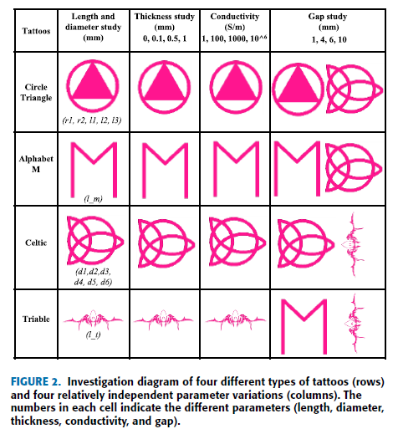
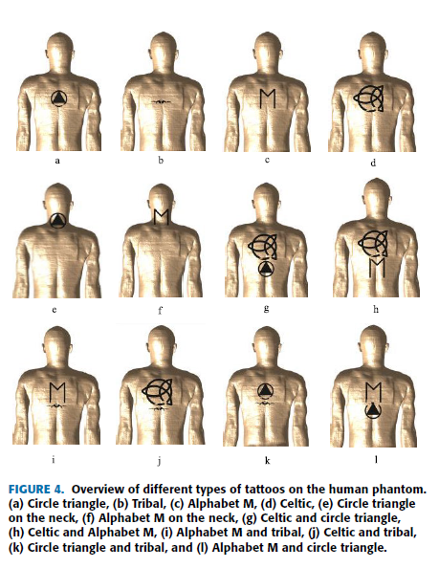
Tattoos: A Simulation
Notes:
2021/07/16 RF-Induced Heating of Various Tattoos at Magnetic Resonance Imaging Systems
VL - 9
DO - 10.1109/ACCESS.2021.3097145
JO - IEEE Access

Slide 14
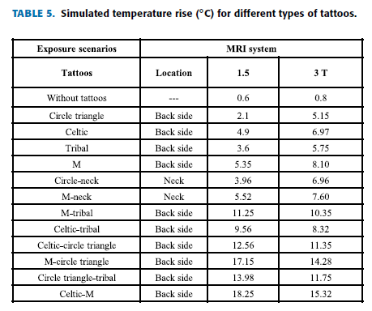
Tattoos
Riskiest tattoos in this simulation:
-long straight bars like on the capital M
-sharp pointy details like in the Celtic tattoo and the tribal tattoo
-multiple tattoos close together (10mm or less)
Notes:
2021/07/16 RF-Induced Heating of Various Tattoos at Magnetic Resonance Imaging Systems

Slide 15
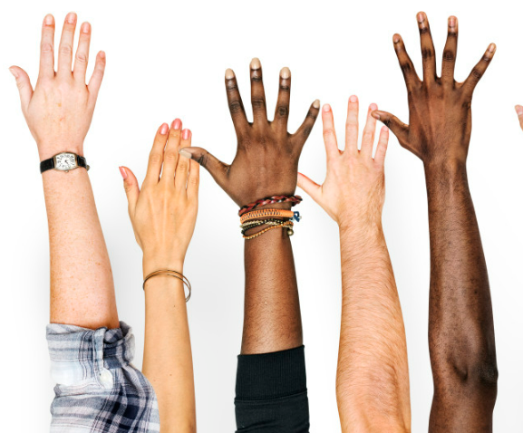
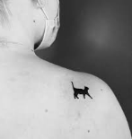
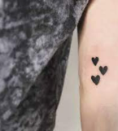
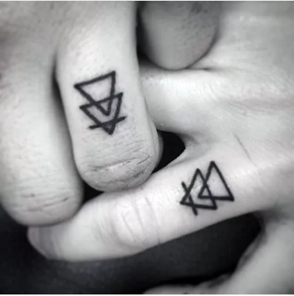
Tattoos with the least risk:
Least risk:
No tattoos!
Some risk:
Small tattoos (<2 cm height and width)
Solid tattoos
Multiple small solid tattoos

Slide 16
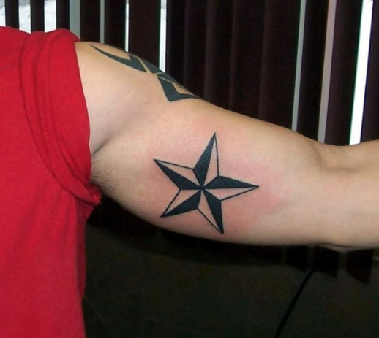
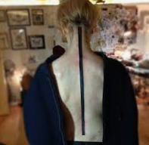
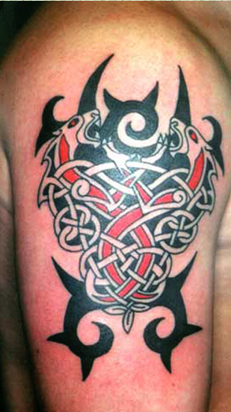
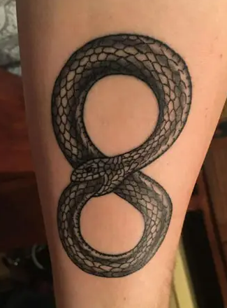
Tattoos with moderate/ high risk:
Moderate/ high risk:
Tattoos with straight lines
Tattoos with sharp edges
Tattoos with adjacent points
Tattoos with circular loops
Tattoos with dense dark color

Slide 17
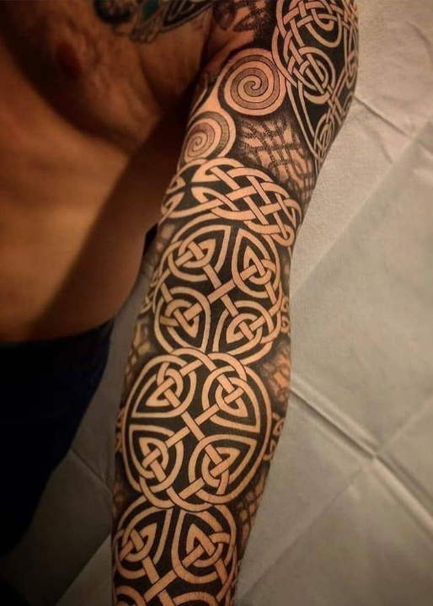
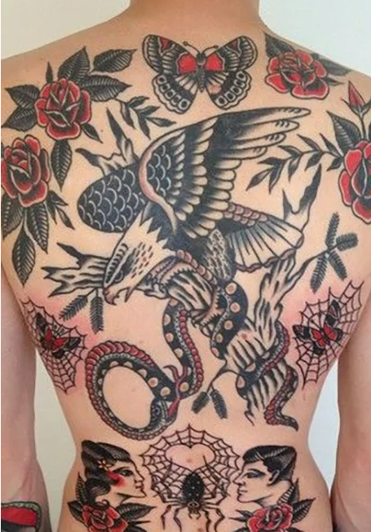
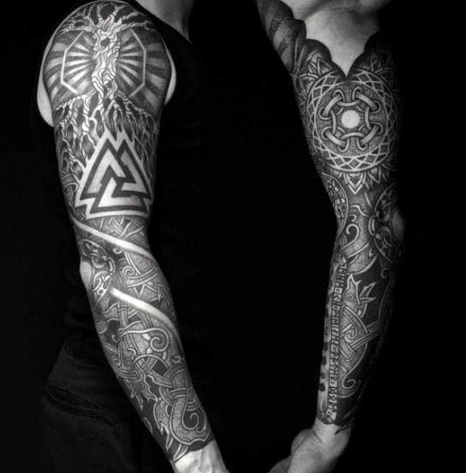
Tattoos with unacceptable risk:
Unacceptable risk:
Multiple tattoos, close together
(10 mm or less spacing), with
straight bars and
sharp pointy corners

Slide 18
Notes:
The bad news: this means you might hear “no” a lot from our MR safety officer. They can assess the specifics of a participant’s implant or tattoo, and they’ll determine what sort of scans are needed and how risky those could be. But ultimately, since only minimal risk can be allowed in research, a good amount of participants won’t be able to participate. This is to keep participants as safe as possible, and to keep your team in compliance with the IRB. The good news: we’ll do everything we can to include everyone we can.

Slide 19
Potential Situations During Safety Screening
Unexpected positive pregnancy test
Administering pregnancy tests to men
Participant will not take pregnancy test or answer questions related to pregnancy, date of last menstrual period, or birth control
Notes:
“It looks like I’m getting a positive on the pregnancy test. Here’s what we’ll do: we’ll try it again with another test, just to verify.” Give the person another the pregnancy test. If positive again: “ok, we got another positive on this test. Since we can’t be certain the scan will be safe, we’re going to cancel the scan for today.” Tell participant to reach out to their doctor for an in-office test. Say you’ll follow up in a few days to see where things stand and work out what to do next, regarding the MRI. Move on to the next part of the day or wrap up here for the day.
Transmen who have kept their reproductive organs-- uterus, ovaries, fallopian tubes-- may be able to become pregnant and bear children. They are aware of this; they may menstruate, they need pap smears. It’s private, of course, but they are aware of it. You should ask, during the initial screening conversation before the scan day, “we have to administer a urine pregnancy test to everyone who has a uterus. Do you have a uterus?” If they say no, you move on. If they say yes, they need to take a urine test on scan day: “And here’s the urine test we discussed on the call. Here’s how to use it…”
“I understand why you prefer to not share this information, and that’s absolutely your right. We do need it before the scan, but we can of course cancel the scan. Can I briefly tell you just why we need this information, when it comes to an MRI scan? We do have to get a urine pregnancy test from everyone who has a uterus. We do have to know about all implanted devices including IUDs and implants like Nexplanon, for your safety in the MRI. We keep this information secure. Can I tell you about the ways we protect your data? We comply with HIPAA privacy guidelines-- our study will be shut down if we don’t-- which means all of the information you share is stored (provide your specific details, for example in a locked cabinet, in a locked office, in a restricted access building). (ONLY if you have a certificate of confidentiality: this study has a federal certificate of confidentiality, or COC. We will not turn over these records to any authority, even if subpoenaed. This COC protection lasts forever.) Last, these records are destroyed after 7 years. In light of this information, would you be willing to (take the pregnancy test/ answer the questions/ etc)?” If not, you say “no problem, we’ll just cancel the scan, and (move on to the next part/ wrap up here for the day).” Be professional. They have withdrawn consent, which is their right to do at any point in the process.
Overall, keep in mind: you are a professional. You are a trained researcher at Columbia University. You are in charge of keeping your participants safe, even if that means they can’t participate.

Slide 20
Potential Situations During Safety Screening
Participant unwilling to change out of street clothes into scrubs
Participant unwilling to remove wig, toupee, weave
Participant unwilling to remove underwire bra
Participant unwilling to change clothes or remove jewelry for religious or cultural reasons
Notes:
In a lot of these cases, the scan won’t happen. If they refuse to comply with the safety regulations that they knew about in advance, they have wasted your time and theirs. It’s unfortunate, but it’s better than a safety incident. The only issue is if they still want to do the scan, don’t understand why there’s no scan, insist on entering Zone 4 despite not passing their safety checks, “but I’ve had MRIs before; this is stupid!”. That’s when you need to be firm and polite. Ultimately, this is for your participant's safety, for their own good.

Slide 21
Potential Situations During Safety Screening
Participant might be too large for scanner bore
Participant with visible thermoregulation issues (sweating, gasping while at rest) but did not indicate issue on screener
Participant with any other visible issues who did not indicate issue on screener
Notes:
In a lot of these cases, the scan won’t happen.
For a larger participant, show them the scanner and the bore. Ask if they wish to attempt being scanned, or if they prefer to opt out of the MRI scan.
If they have visible issues not on the screener, ask the MR Safety Officer or cancel the scan. It’s unfortunate, but it’s better than a safety incident.

